Slide 1







Slide 2

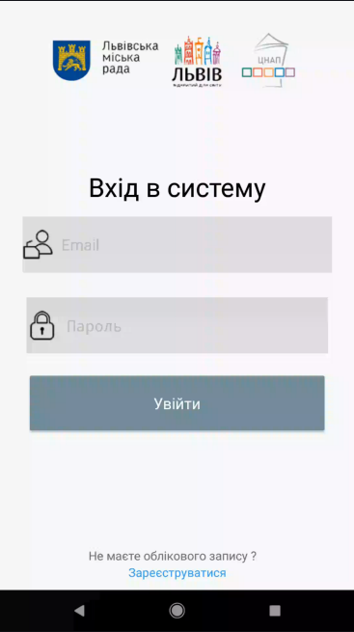
CNAP
NATIVE ANDROID APP FOR IPHONE*
*It`s a joke ☺

Slide 3

Members
Zavarynskiy Nazar
Kromkach Vladyslav
Blyzniuk Andrian
Chycherskiy Vitaliy
Stefanyshyn Nazar
Klochnyk Yaroslav
Mentor

Slide 4
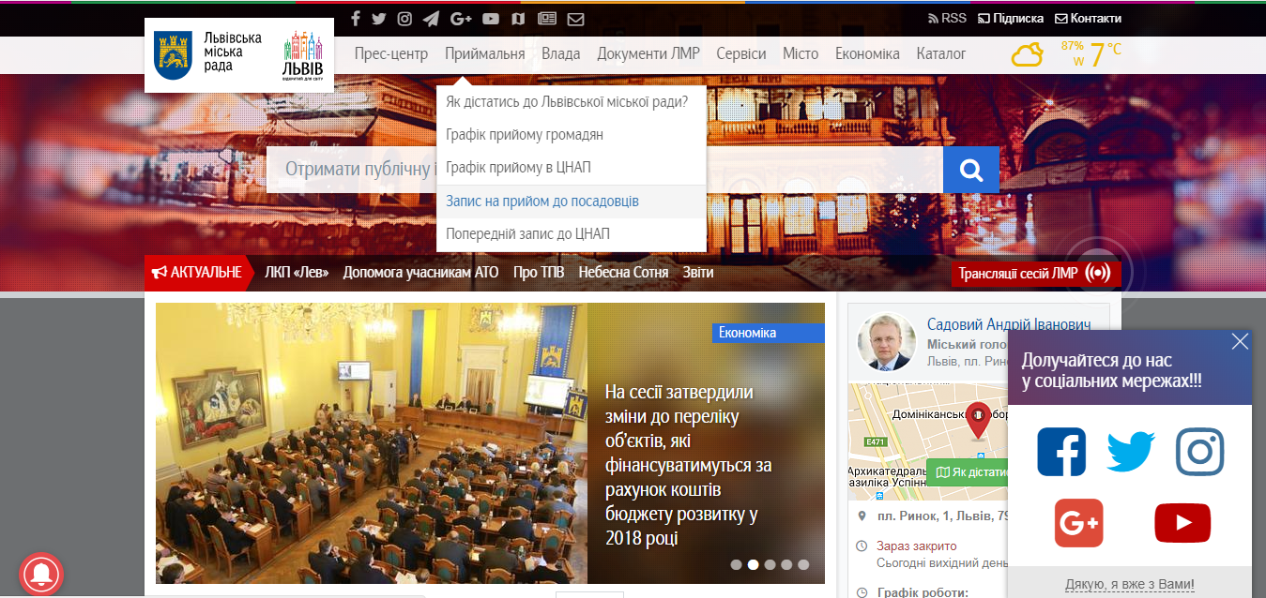
IDEA
The main idea was to have an ability to use mobile device for subscribing to a CNAP or to a particular official person.

Slide 5



Advantages
Opponents:
View the queue state
Users can subscribe to a CNAP
…to an audience with official person.
Add an overview
Online support
Register of services
Web version in the app
- Long load time
+ The same functionality - Design

Slide 6





FRONT-END
BACK-END
Mobile User App
Server
Request
HTTP(S)Protocol, JSON Data
Response
Request
Request
Response
Response
HTTP(S)Protocol, JSON Data
Admin Web
Database

Slide 7




MOBILE
What we used?
Java Android
Retrofit 2
AES + Cipher encryptor/decryptor

Slide 8




WEB
What we used?
HTML5/CSS3
JS
jQuery/jQuery UI
Bootstrap

Slide 9





BACK-END
What we used?
Python
Django
Django rest framework
Python anywhere
Cipher + AES encryptor/decryptor
Cors-headers
Django-filters
MySQL

Slide 10



Communication
What we used?
Version control : GitHub
Task controller: Trello
Team messenger: Slack

Slide 11
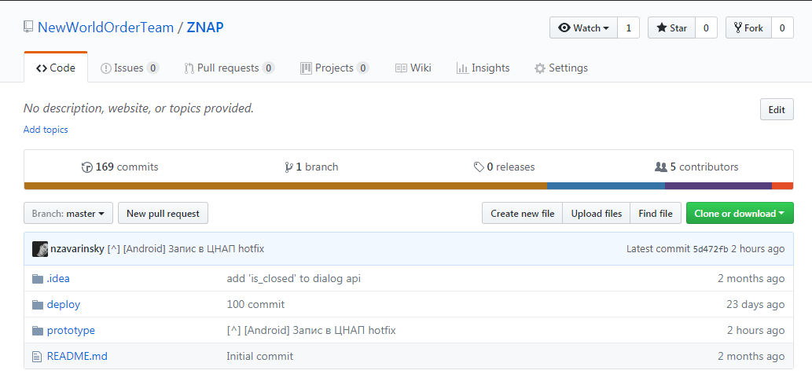
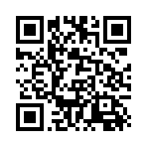
OUR GITHUB REPO

Slide 12
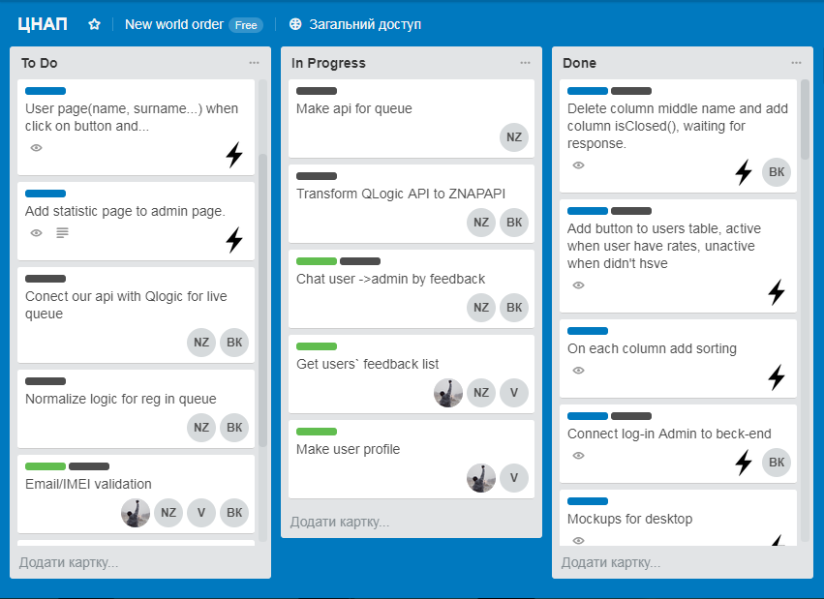
OUR TRELLO

Slide 13
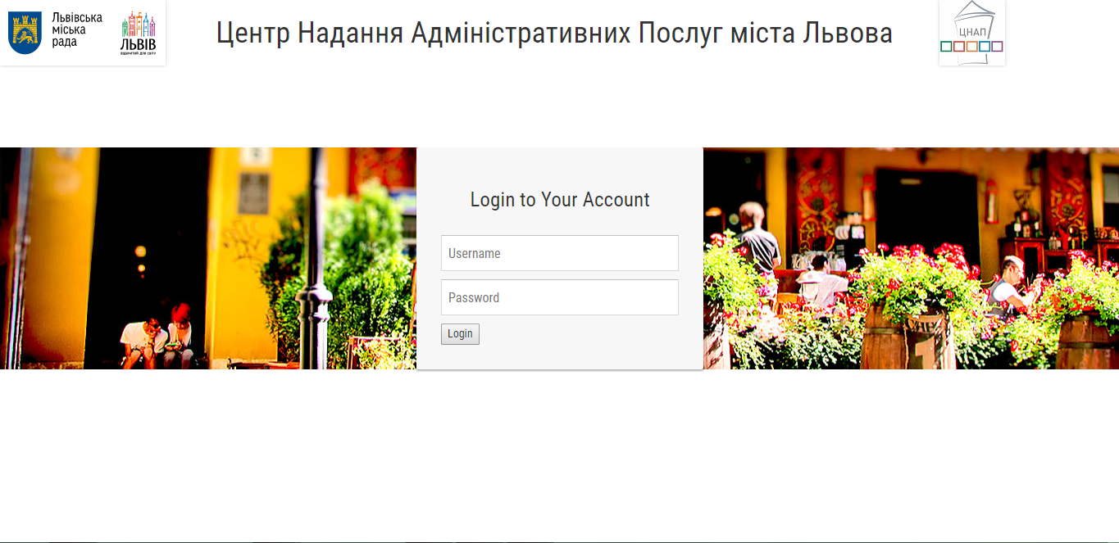

Slide 14
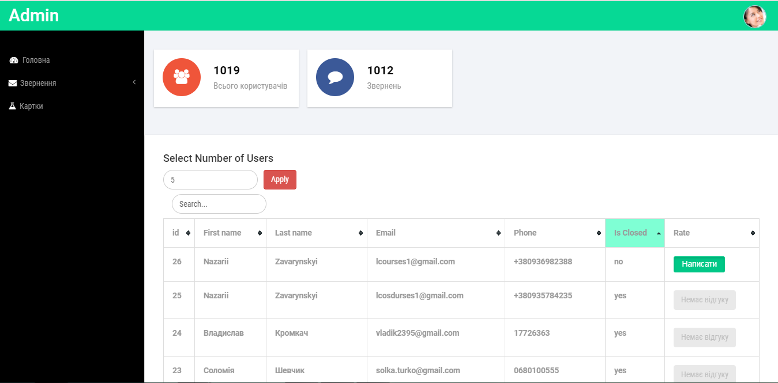

Slide 15
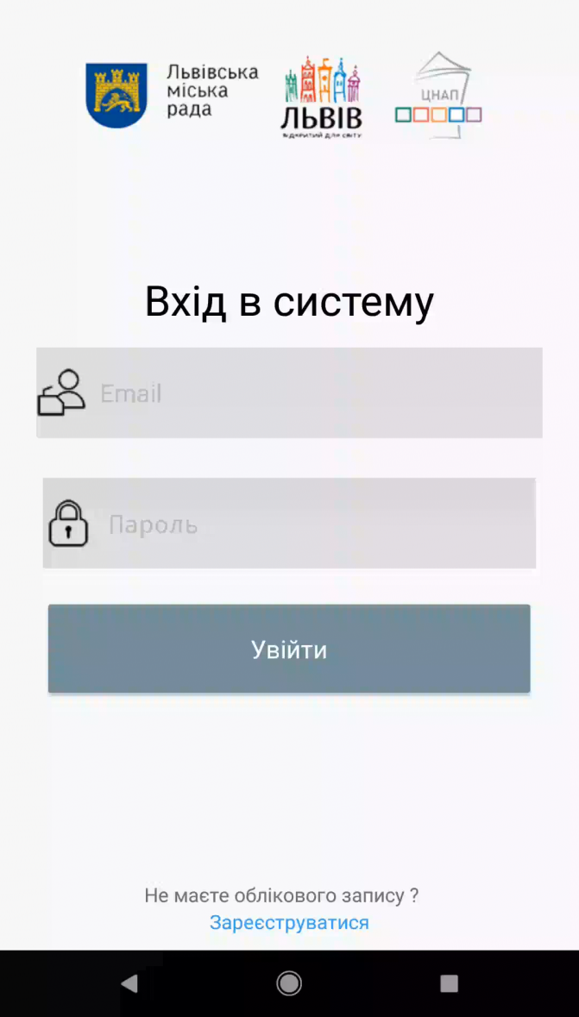
DEMO

Slide 16


FUTURE PLANS
Next steps:
Integration with QLogic
Finishing Admin`s page
Security (IMEI validation)
Publishing on Play Market (approximately May, 2018)
IOS version (December, 2018)

Slide 17

Any Questions

